Slide 1
Tableau First Steps
Getting Started Building Compelling Visualizations

Slide 2
Poll
What industry are you in?
Retail
Education
Healthcare
Finance/Insurance
Government
Realestate
Manufacturing
Other

Slide 3
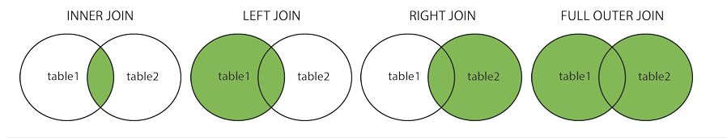
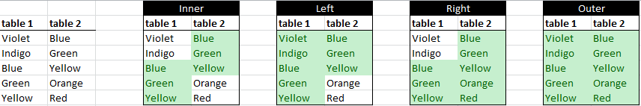
Joins and Join Types

Slide 4
Tableau 2020 Changes
Relationships are no longer viewed by a Venn diagram.
Cardinality - How many entries in one table are related to how many entries in the other?
One to one
Many to one or one to many
Many to many
Referential Integrity - Do joined field entries in the joined table all have valid counterparts in the primary table?
Some match
All match

Slide 5
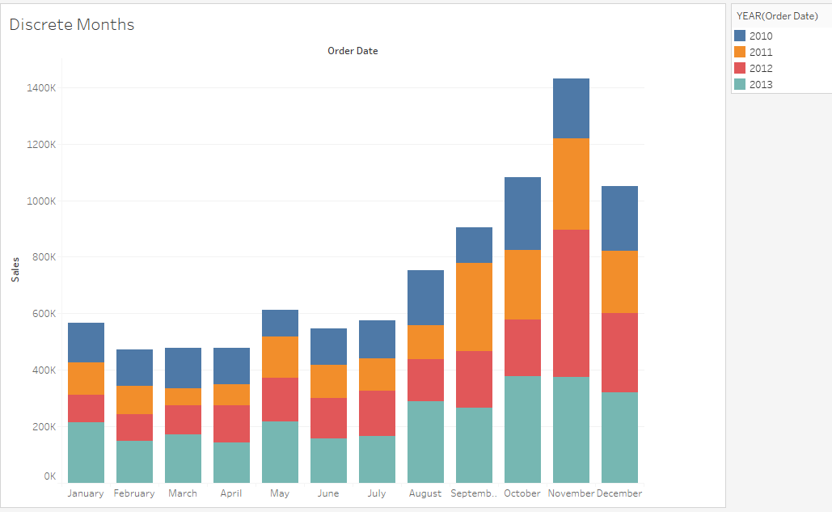
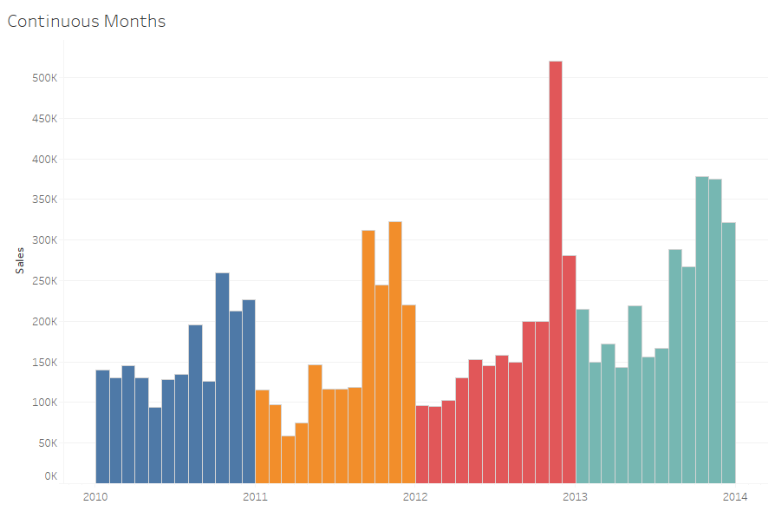
Discrete Versus Continuous

Slide 6
Exercise I
Find the sum of sales for the furniture product category in 2012. Was it higher or lower than 2011?

Slide 7
Exercise II
Management is concerned with how much profit is being made in the Product Sub-Category of Telephones and Communication. Create a map to help them identify which part of the country to address to improve profit numbers.

Slide 8
Exercise III
After showing management your map, they are now wondering what percentage of profit Telephones and Communication represented in 2013. Create a table calculation on profit to determine what this value is.

Slide 9
Exercise IV
The managers now want to see what would happen to overall profit in 2014 if they were able to increase all areas by 15%. Create a calculation that adds 15% to the 2013 profit values and show it, along with the actual values on a crosstab.

Slide 10
Additional Resources
Download Tableau Desktop:
https://www.tableau.com/support/releases
Connecting to Data Sources:
https://help.tableau.com/current/pro/desktop/en-us/datasource_prepare.htm
Understanding Table Joins:
https://www.w3schools.com/sql/sql_join.asp
Create a custom Tableau color palette:
https://help.tableau.com/current/pro/desktop/en-us/formatting_create_custom_colors.htm

Slide 11
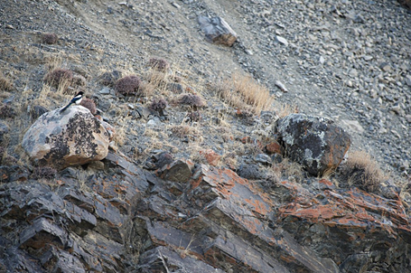
Why Visualize?

Slide 12
Why Visualize?

Slide 13
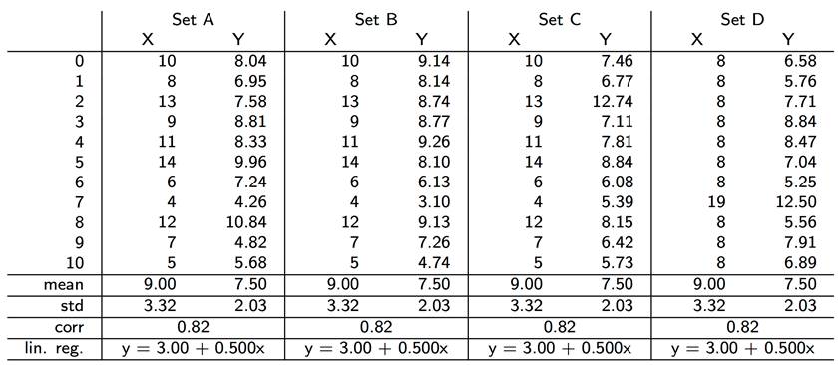
Why Visualize?
Notes:
Do these data sets share the same distribution?
Are they all linear?
Notice that the correlation, mean, standard deviation, and regression all match

Slide 14
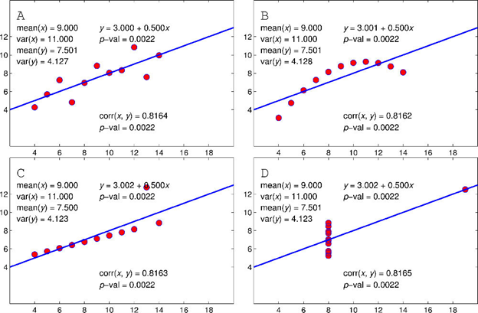
Why Visualize?
Notes:
A is probably an accurate fit. The points more or less follow a linear pattern
B has a pattern, but it definitely isn’t linear
C Looks linear, but there is an obvious outlier - data issue?
D The linear pattern only works because of the one strong X outlier. Otherwise, X is always 8.

Slide 15
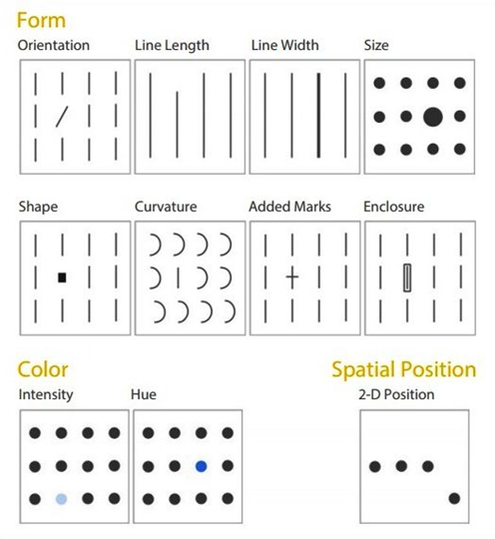
Pre-Attentive Attributes
Notes:
What you see before you see it.

Slide 16
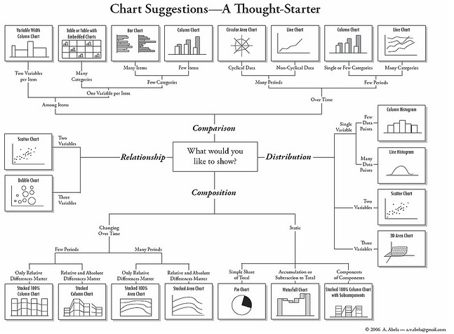
What Visualization Should Be Used?
Google: Which visualization to use?

Slide 17
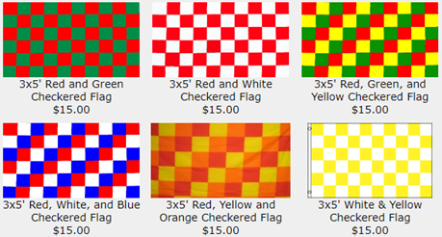
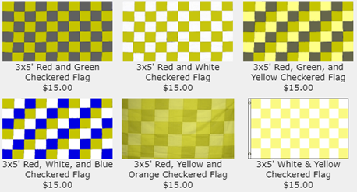
Be Careful With Color...
Notes:
8% of men and 1% of women have some form of colorblindness
Chrome Plug-in: NoCoffee

Slide 18
Layouts Have Meaning
You have 5-10 seconds
Rule of 3
‘F’ and ‘Z’

Slide 19
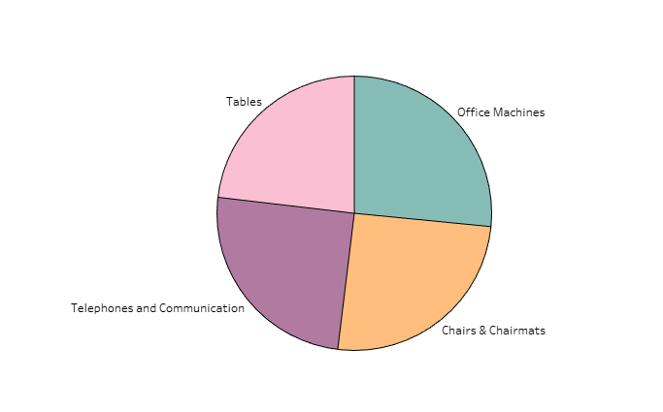
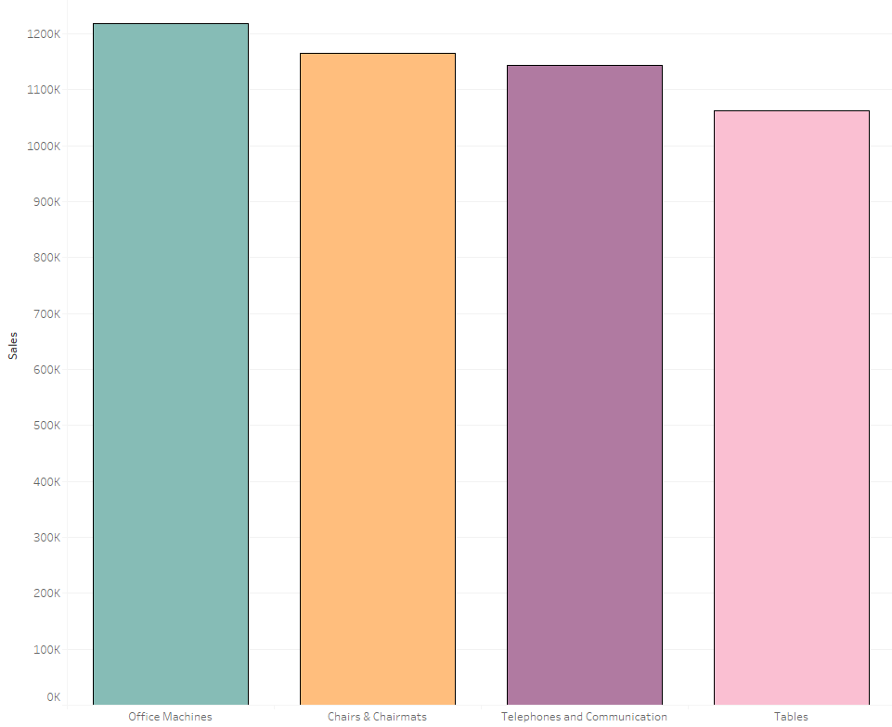
Pie is for Eating
Notes:
Humans are horrible at area, especially when radians are involved.

Slide 20
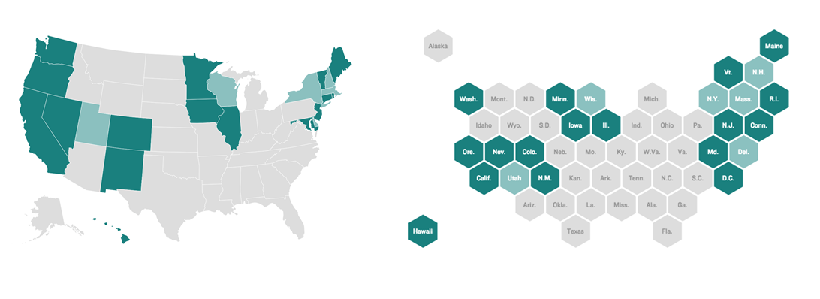
Maps Can Mislead

Slide 21
Changing Data
Ok to change labels to match
Not ok to change numbers
Report what is in the data
Provide a carrot, but have a stick

